Slide 1
Exploring Tie Formation and Collaboration Patterns among Music Artists
Rafael Godinho

Slide 2
Table of contents
01
02
03
04
Data
Visualizations
Analysis
Conclusion & Remarks

Slide 3


01
Data

Slide 4
Data Summary & Collection
Summary
Since 2017, streaming services have become the primary source of revenue within the global recorded music market. The networks of collaborating artists were obtained from Spotify Charts for the US market in 2017. Artists are linked when they collaborate on a hit song (i.e. this song appears on a Spotify Top 200 Chart)
Collection
The data was collected through Zenodo.com. The source of the data was collected by Gabriel P. Oliveira, Mariana O. Silva, Danilo B. Seufitelli, Anisio Lacerda, and Mirella M. Moro. Detecting Collaboration Profiles in Success-based Music Genre Networks. In Proceedings of the 21st International Society for Music Information Retrieval Conference (ISMIR 2020), 2020.

Slide 5
Artist Collaboration Network
Artist1
Artist2
Artist name (Ego)
779 unique artists
Artist name (Alter)
Count
Song_ids
Number of hit songs in which both artists collaborated.
Spotify ID for each hit song containing both artists.

Slide 6
Artist Dataset
Name
Popularity
Artist name
Artist's overall popularity on a scale from 1-100
Genres
List of the artist's music genres

Slide 7
Representation & Strengths/Weaknesses
Representation
Strengths
Weaknesses
The population represented by this data are collaborating artists who contributed to hit songs within the US market.
The dataset includes weekly charts of the 200 most streamed songs over the span of the years as well as a success-based artist collaboration networks, allowing for insights into the dynamics of the music industry and artistic collaborations.
The dataset is built using data from Spotify, which means it may not fully represent the entire music consumption landscape. Other streaming platforms and offline music consumption patterns are not considered.

Slide 8

02
Visualizations

Slide 9
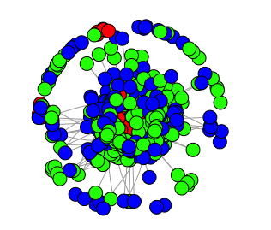
Network Visualizations
Degree > 8
1 < Degree ≤ 8
Degree = 1
Mercury is small
** Kamada-Kawai layout

Slide 10
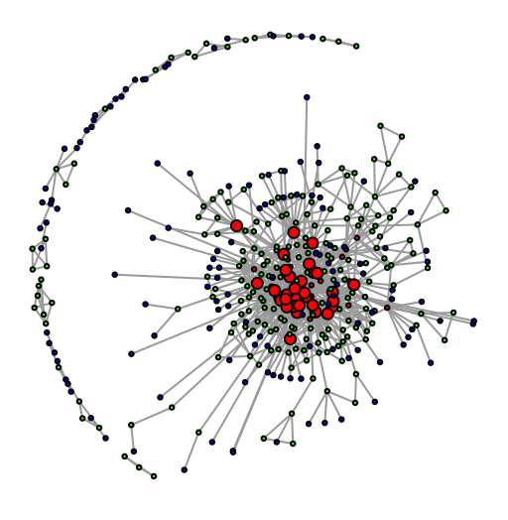

Slide 11
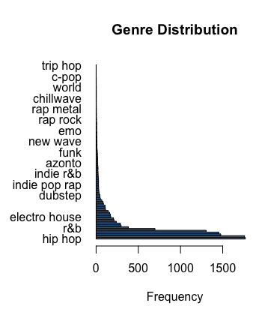
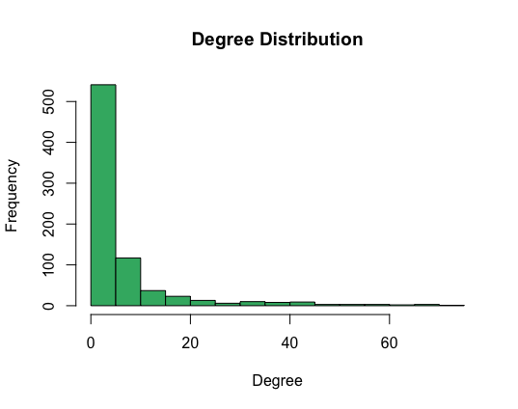

Slide 12
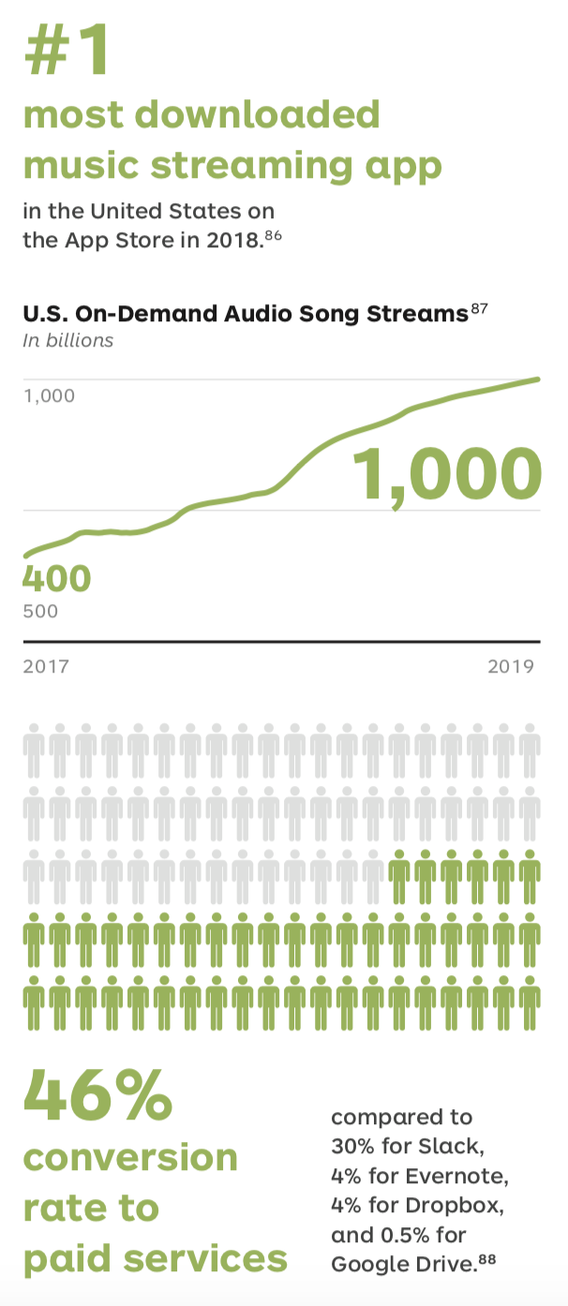
03
Analysis

Slide 13
Analysis
Created a network object using the artist collaboration data
Merged the artist information dataset with the collaboration data, incorporating the vector attributes as well.
Nodematch was utilized in the ERGM model to better examine the effects of attribute similarity on tie formation. D
Done by comparing the attributes of each pair of nodes in the network.

Slide 14
Estimate Std. Error MCMC % z value Pr(>|z|)
edges -4.95892 0.03643 0 -136.140 <1e-04 ***
nodematch.hit_songs 0.02579 0.04516 0 0.571 0.568
nodematch.popularity -0.03315 0.11006 0 -0.301 0.763
nodematch.genres -0.28756 0.23152 0 -1.242 0.214
---
Signif. codes: 0 ‘***’ 0.001 ‘**’ 0.01 ‘*’ 0.05 ‘.’ 0.1 ‘ ’ 1
Null Deviance: 420090 on 303031 degrees of freedom
Residual Deviance: 25442 on 303027 degrees of freedom
AIC: 25450 BIC: 25492

Slide 15
Results
The edges coefficient of -4.95892 suggests that the presence of edges has a strong negative effect on tie formation.
Nodematch.hit_songs coefficient of 0.02579 suggests a positive but weak effect, although it’s not statistically significant based on the p-value of 0.568 (> 0.05).
Nodematch.popularity coefficient of -0.03315 suggests a negative but weak effect, although it’s not statistically significant based on the p-value of 0.763 (> 0.05).

Slide 16
Results (cont.)
Nodematch.genres coefficient of -0.28756 suggests a negative but weak effect, although it’s not statistically significant based on the p-value of 0.763 (> 0.05).
Nodematch.hit_songs coefficient of -0.05900 suggests a negative but weak effect, although it’s not statistically significant based on the p-value of 0.214 (> 0.05).
The AIC value of 25450 and the BIC value of 25492 indicate that the model has relatively good fit when considering the complexity of the model

Slide 17

04
Conclusion & Remarks

Slide 18
Conclusions
A negative coefficient for the edges term indicates that as the number of existing collaborations increases, the likelihood of forming new collaborations decreases.
Suggests that artists prefer to repeating collaborations with the same individuals rather than seeking out new or different ones.
Artists likely maintain the established relationships they already have, rather than actively seek out new ones. This may be due to shared artistic vision, chemistry, trust or previous successful collaborations

Slide 19
Conclusions (cont.)
The analysis revealed that there is no significant association between the number of hit songs, shared genres, or popularity of two artists and the likelihood of forming a tie/collaboration
Tie formations may be driven by other factors such as personal connections, shared interests or other social and professional networks
Important to consider other factors such as personal relationships, artistic preferences, management decisions and industry dynamics that may influence tie formations

Slide 20
Remarks
Structure of data in this format resembles a scale-free network as described by Barabasi & Bonabeau.
Analysis supports the idea that the presence of existing collaborations (edges) in the network plays a more significant role in determining future collaborations between artists, rather than the number of hit songs they have

Slide 21
Remarks (cont.)
The complete data set contains the Spotify charts from eight of the top 10 music markets from 2017-2019, the global charts and a genre collaboration network. For this analysis, only the US data was used.
I’d like to analyze each year separately and examine how the network structure and attribute correlations change over time
I’d also like to develop predictive models to forecast future collaborations or attribute values based on historical patterns

Slide 22
Thanks!

